Slide 1
iptables

Slide 2
iptables
The firewall solution in Linux is netfilter (https://www.netfilter.org/).
It is a packet filter inside Linux kernel.
Enables
Packet filtering
NAT/PAT (Port)
Packet logging
etc
The netfilter project is controlled by iptables and its successor nftables.
iptables is a generic firewall software that allows you to define rulesets. Each rule within an IP table consists of a number of classifiers (iptables matches) and one connected action (iptables target).
nftables is the successor of iptables, it allows for much more flexible, scalable and performance packet classification. This is where all the fancy new features are developed.
Netfilter is an infrastructure; it is the basic API that the Linux 2.4 kernel offers for applications that want to view and manipulate network packets. Iptables is an interface that uses Netfilter to classify and act on packets.

Slide 3
More Technical Details
netfilter belongs to the kernel space and iptables belongs to the user space
Only root user can configure the netfilter framework

Slide 4
Chain Traversal
Incoming traffic is filtered on the input chain of the filter table
Outgoing traffic is filtered on the output chain of the filter table
Routed traffic is filtered on the forward chain of the filter table
SNAT/Masquerade is filtered on the postrouting chain of the nat table
DNAT/Port forwarding is filtered on the prerouting chain of the nat table
To modify values from the packet’s headers, add rules to the mangle table
To skip the connection tracking, add rules with NOTRACK target to the raw table

Slide 5
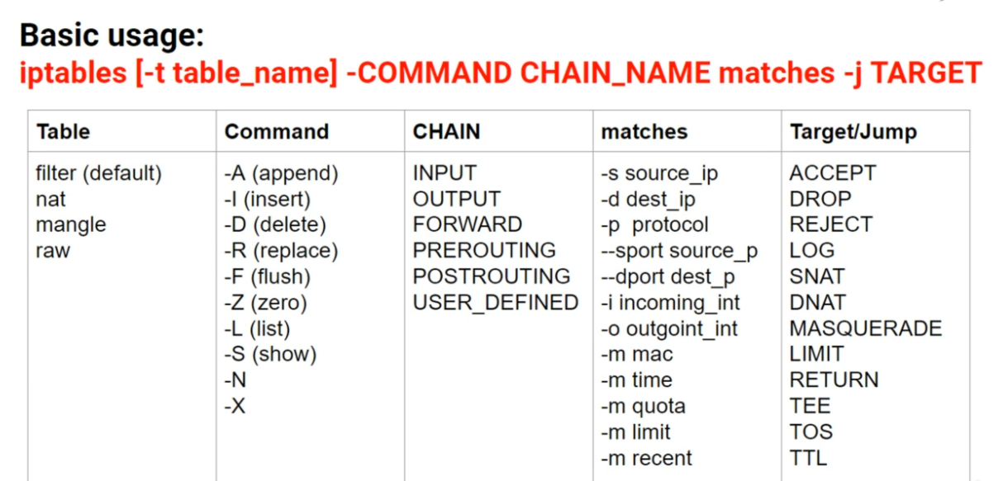
iptables Command

Slide 6
iptables Hands-on

Slide 7
Requirements
Oracle VirtualBox
Install Some linux (e.g. Kali Linux)
Install a second VM (e.g. Metasploit machine)

Slide 8
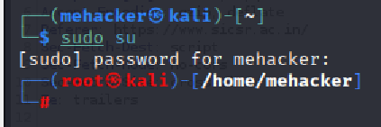
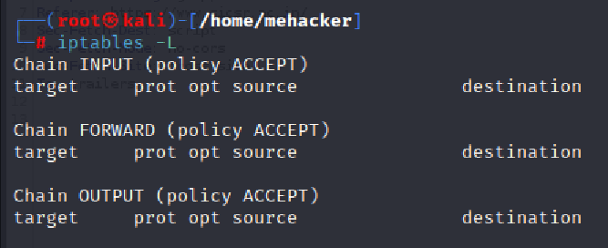
Kali Linux - Login as su
On the Kali Linux VM, sudo su and password for your user id
iptables -L

Slide 9
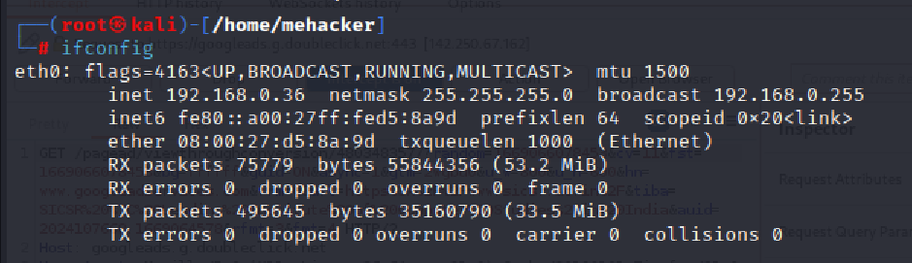
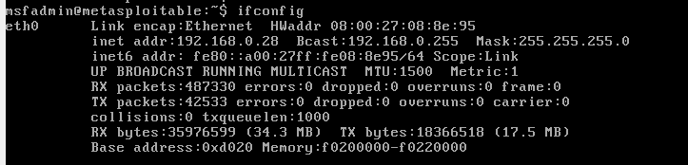
Check IP Addresses of Both
Kali Linux: ifconfig
Metasploit: ifconfig

Slide 10
Exercise 1: Try Adding a Rule Using iptables
Kali Linux IP address was 192.168.0.36
Metasploit IP address was 192.168.0.28
Ping Kali from Metasploit – Make sure it works
Then add iptables rule to Kali to drop the packet
Metasploit ping to Kali should stop

Slide 11
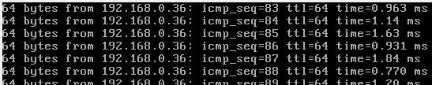
On Metasploit: ping 192.168.0.36
On Kali: iptables -t filter -A INPUT -p icmp --icmp-type echo-request -j DROP

Slide 12
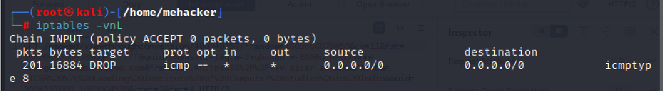
Result
L = List rules
v = Display detailed information
n = Display IP addresses and port numbers in numeric format
Check Metasploit: ping should have stopped
On Kali: iptables -vnL

Slide 13
Exercise 2: Do not Allow Kali Machine to Access www.ubuntu.com
How to construct this command:
We are going to filter traffic, so we are using the filter table
iptables -t filter
We are going to append a new rule
iptables -t filter -A
We want to match the outgoing traffic, which means the output chain
iptables -t filter –A OUTPUT
We want to match the outgoing traffic, which means the output chain
iptables -t filter –A OUTPUT
Matching conditions: protocol = TCP, destination port = 80, URL: www.ubuntu.com
iptables -t filter -A OUTPUT -p tcp --dport 80 -d www.ubuntu.com
Execute (j)ump to the following result: drop the packet
iptables -t filter -A OUTPUT -p tcp --dport 80 -d www.ubuntu.com -j DROP

Slide 14
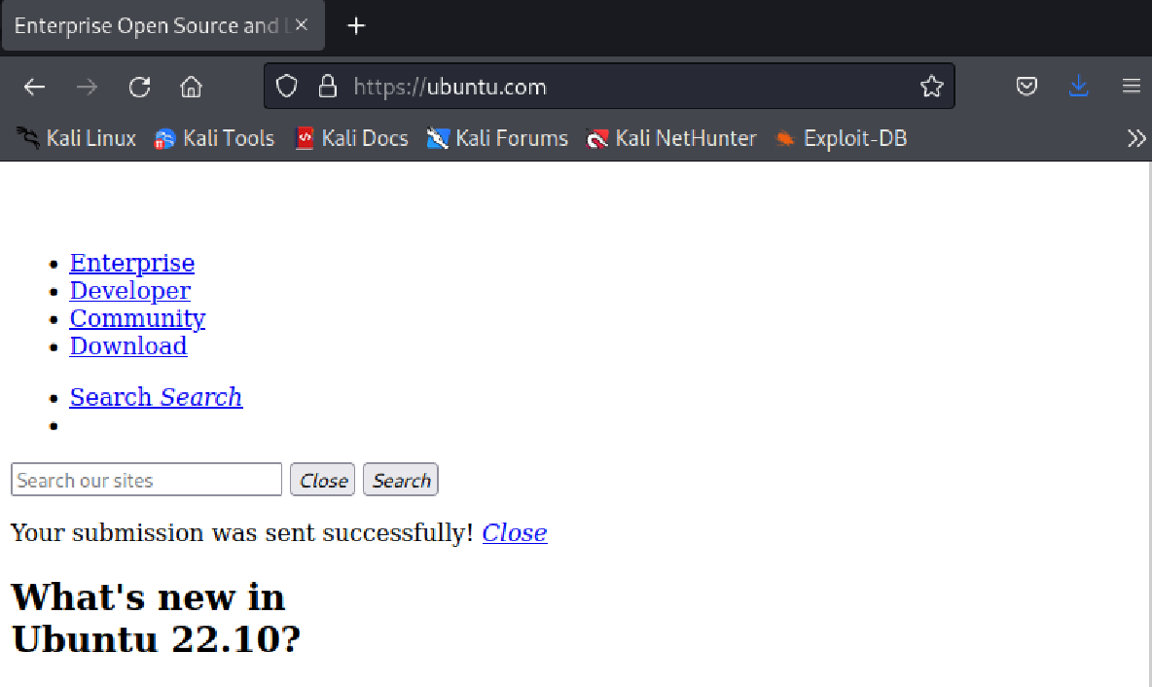
Let us first check if the page is accessible

Slide 15
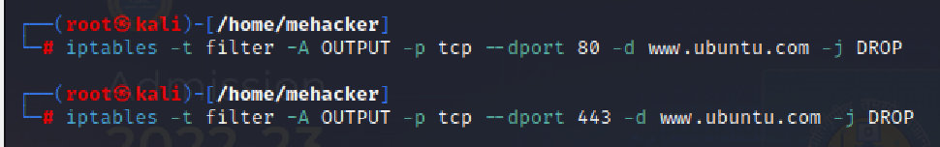
Now Add iptables Rule for Port 80 and 443 Also
iptables -t filter -A OUTPUT -p tcp --dport 80 -d www.ubuntu.com -j DROP
iptables -t filter -A OUTPUT -p tcp --dport 443 -d www.ubuntu.com -j DROP

Slide 16
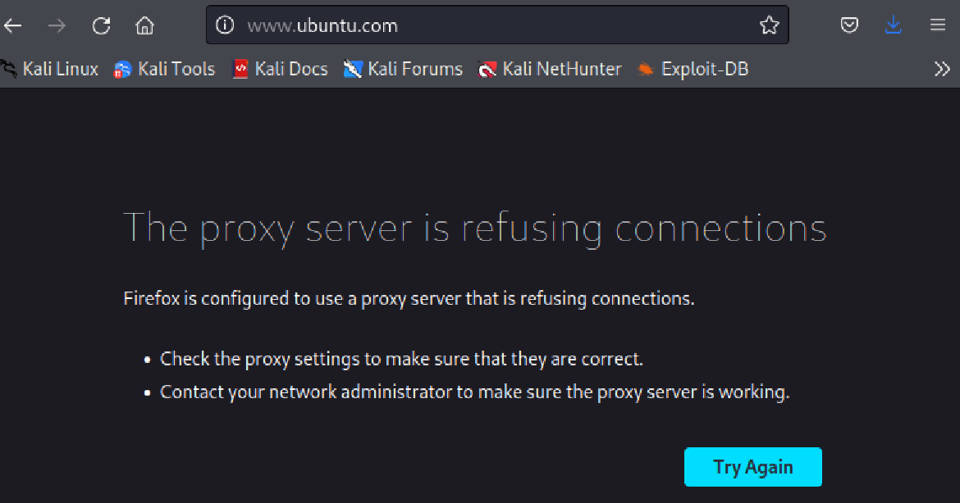
Now Try Accessing www.ubuntu.com Again
Specifically try www.ubuntu.com (As mentioned in our filtering rule)

Slide 17
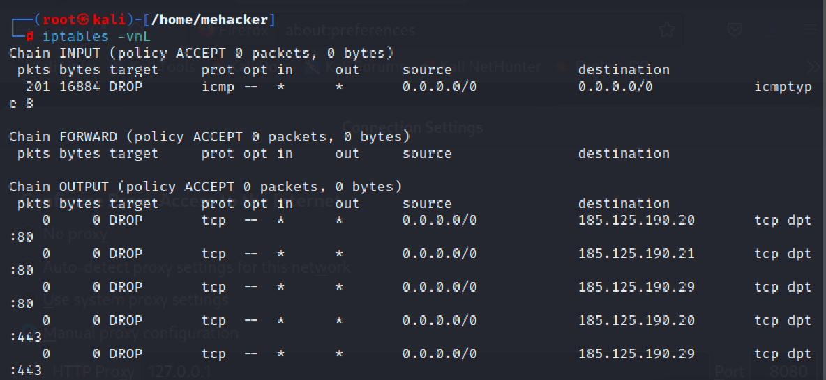
Verify
iptables -vnL

Slide 18
Prevent an External/Remote Host from Pretending to be Local to your Network
Logically:
iptables -A INPUT -i external_interface -s your_IP_address -j REJECT
Example (Assuming our network address is 192.168.18.0)
iptables -A INPUT -i external_interface -s 192.168.0.0/24 -j REJECT
DROP versus REJECT
The Linux firewall can refuse packets in two manners. iptables calls them DROP and REJECT, while ipchains uses the terminology DENY and REJECT. DROP (or DENY) simply swallows the packet, never to be seen again, and emits no response. REJECT, in contrast, responds to the packet with a friendly message back to the sender, something like "Hello, I have rejected your packet."
REJECT can leave you open to denial of service attacks, with you as the unwitting patsy. Suppose a Hostile Third Party sends you packets with a forged source address from a victim site, V. In response, you reject the packets, returning them not to the Hostile Third Party, but to victim V, owner of the source address. Voilà—you are unintentionally
flooding V with rejections. If you're a large site with hundreds or thousands of hosts, you might choose DROP to prevent them from being abused in such a manner.

Slide 19
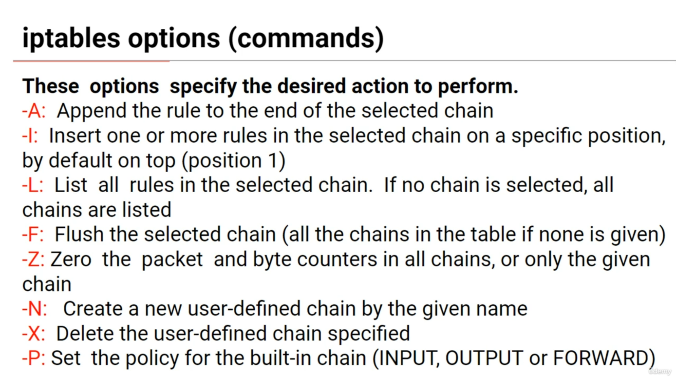
Understanding iptables Options in Detail

Slide 20
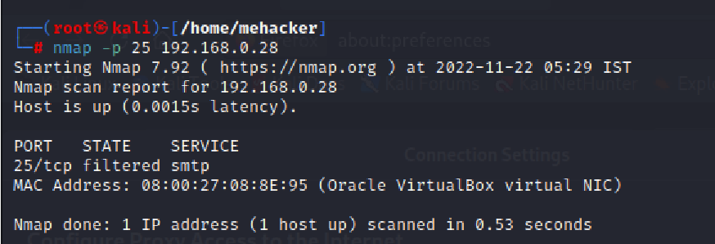
-A Example
iptables -A INPUT -p tcp --dport 25 -j DROP
On Metasploit:
sudo su
iptables -A INPUT -p tcp --dport 25 -j DROP
Then try scanning port 25 of Metasploit from Kali
nmap -p 25 192.168.0.28
If nmap is not installed, sudo apt-get install nmap

Slide 21
Deleting an iptables Rule
First see which rules are implemented: sudo iptables -L on Metsploit
Only for INPUT: sudo iptables –L INPUT
Delete a rule: sudo iptables -D [CHAIN] [LINE_NUMBER]
sudo iptables –D INPUT 1
Verify that it got deleted: sudo iptables –L INPUT
Delete all the rules for input chain: sudo iptables -F INPUT

Slide 22
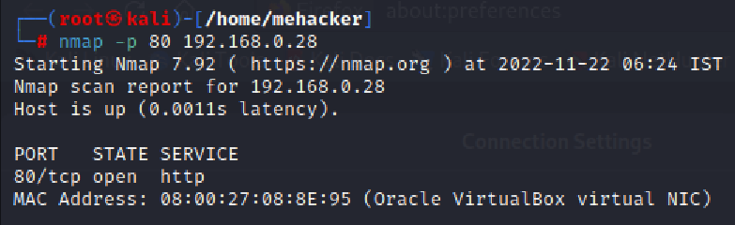
Let us Test for Web Traffic
First install Apache web server on Metasploit: apt install apache2 and if it does not work, apt-get install apache2
Let us scan port 80 of Metasploit from Kali – Success
On Kali: nmap -p 80 192.168.0.28

Slide 23
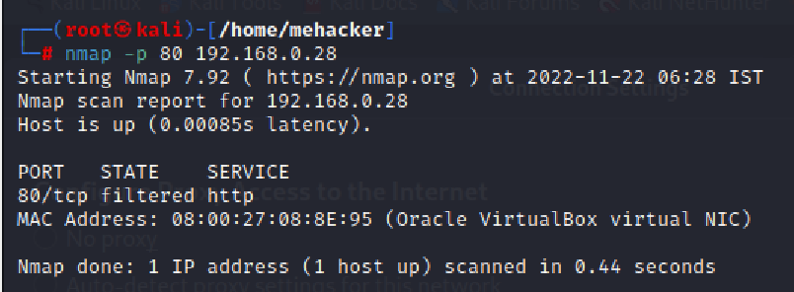
Let us Test for Web Traffic
Now let us run this command on Metasploit:
iptables -A INPUT -p tcp --dport 80 -j DROP
Let us again scan port 80 of Metasploit from Kali
On Kali: nmap -p 80 192.168.0.28

Slide 24
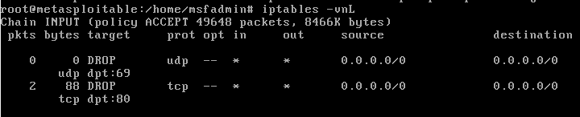
The -I Option
-A appends the rule to the end of the specified chain
But -I adds it at a specific place in the chain, as per the user-defined value iptables -I INPUT 2 -p tcp --dport 21 -j DROP and then iptables -vnL
If no value is specified, it is added at the top of the chain
Let us add a rule on Metasploit: iptables -I INPUT -p udp --dport 69 -j DROP and then iptables -vnL

Slide 25
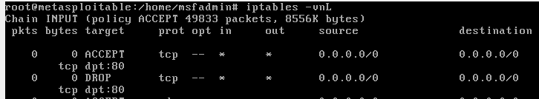
How are Rules Processed?
Top to bottom, in sequence
Hence, it is important to specify the rules precisely where we want them
Add these rules to Metasploit:
iptables -I INPUT -p tcp --dport 80 -j DROP
iptables -I INPUT -p tcp --dport 80 -j ACCEPT
Will the traffic to port 80 be accepted or dropped?
From Kali Linux, try this: 192.168.0.28 in the browser

Slide 26
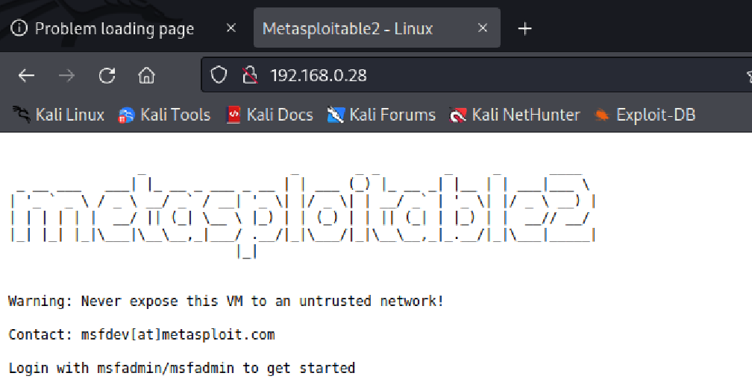
How are Rules Processed?
This is what we get on Kali Linux
Conclusion: ACCEPT got processed, DROP never got processed

Slide 27
Remove the Rules and Add in the Reverse Order on Metasploit
sudo iptables -F INPUT
iptables -I INPUT -p tcp --dport 80 -j ACCEPT
iptables -I INPUT -p tcp --dport 80 -j DROP
iptables –vnL
Try refreshing in Kali Linux … It will not show the Metasploit home page

Slide 28
Where to Write Rules?
Rules written on terminals are executed immediately, but when the computer restarts, they are removed
In such cases, we can add the rules in a shell script, make it executable, and set it to execute at boot time
Example: On the Metasploit machine
cd /
mkdir scripts
cd scripts
nano iptables_example.sh

Slide 29
iptables_example.sh
#!/bin/bash
# drop incoming ssh traffic
iptables -A INPUT -p tcp --dport 22 -j DROP
# drop outgoing http and https traffic
iptables -A OUTPUT -p tcp --dport 80 -j DROP
iptables -A OUTPUT -p tcp --dport 443 -j DROP

Slide 30
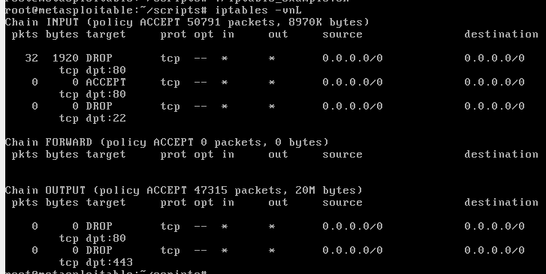
Run it
chmod 700 iptables_example.sh
./iptables_example.sh
iptables -vnL

Slide 31
Default Policy
Policy specifies what happens to the packets when they are not matched against any rule
By default, policy is set to accept all traffic
Policy can be changed only for INPUT, OUTPUT, and FORWARD chains
To change policy, we use the -P option

Slide 32
Default Policy
Default policy can be seen by using the iptables -vnL command

Slide 33
Changing the Policy
First reset the input and policy on Metasploit
sudo iptables -F INPUT
sudo iptables -F INPUT
Verify the status
iptables -vnL

Slide 34
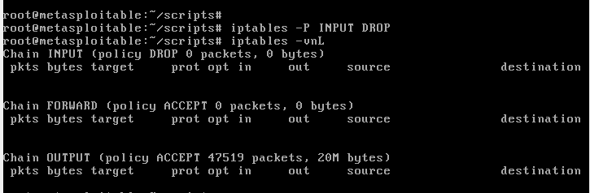
Changing the Policy
Check whether we can ping Metasploit
From Kali Linux machine
ping 192.168.0.28
If ping is successful
On the Metasploit machine: iptables -P INPUT DROP and iptables -vnL

Slide 35
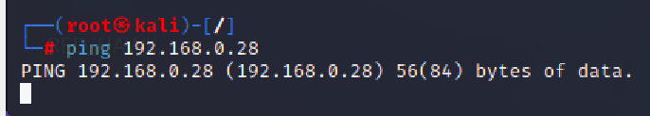
Retry Ping
Check whether we can ping Metasploit
From Kali Linux machine
ping 192.168.0.28
Should not succeed – as expected, it is stuck now
Reverse the policy on Metasploit and recheck – the Kali Linux ping should start progressing

